Slide 1
Package Definition Information
A Package is really no different from a standalone program.
The tools available for getting additional information work for Packages too.
SQL> SELECT object_name, object_type, status
FROM user_objects
WHERE object_type IN ('PACKAGE', 'PACKAGE BODY');
OBJECT NAME OBJECT_TYPE
------------------------- ------------------------
PERSONNEL PACKAGE BODY
PERSONNEL PACKAGE

Slide 2
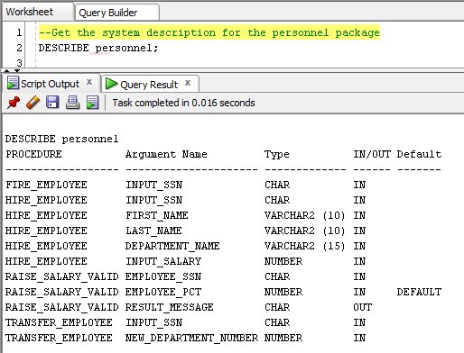
Using DESCRIBE
 Notice only the public interface is visible.

Slide 3

See it in Action

